Slide 1
Pattern Extraction
Stauffer Guy-Raphaël and Chevalley Gibran

Slide 2


Previous work

Slide 3
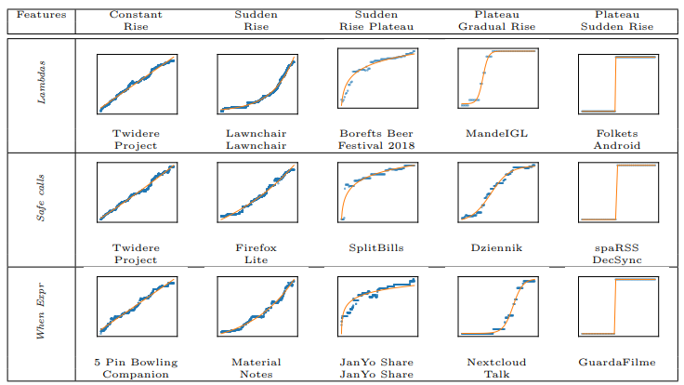
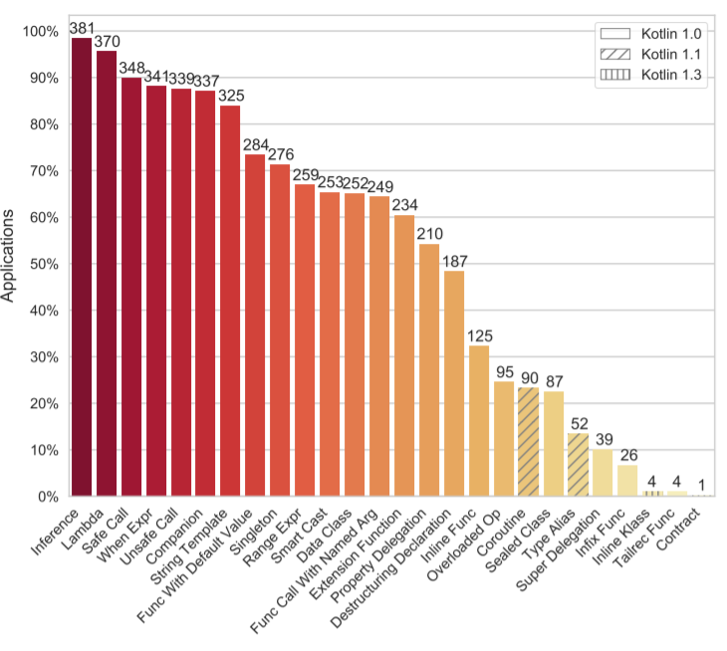
Previous work

Slide 4


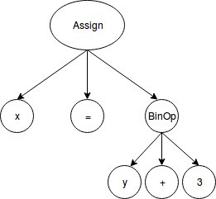
Two keypoints
AST

Slide 5

Github API
GET https://api.github.com/search/repositories?q=language:Swift&sort=stars&order=desc

Slide 6
Github exploration
apple
swift
0000_Main.swift
0001_Requires.swift
...
Alamofire
Alamofire
0000_ContentView.swift
0001_DispatchQueue+Alamofire.swift
…
…

Slide 7

Github exploration

Slide 8
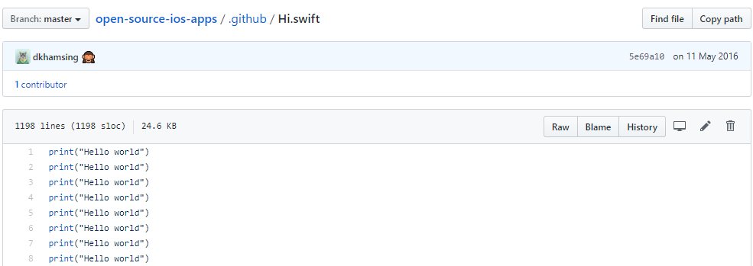
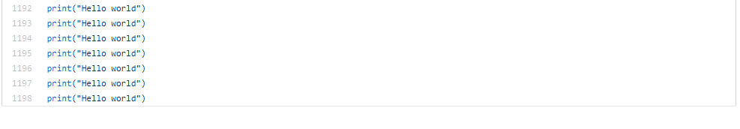
…

Slide 9
Sources
Mateus, Bruno Góis, et Matias Martinez. « On the Adoption, Usage and Evolution of Kotlin Features on Android Development ». ArXiv:1907.09003 [Cs], 20 janvier 2020. http://arxiv.org/abs/1907.09003.

